Slide 1
FINITE ELEMENT ANALYSIS OF STEEL PLATE SHEAR WALL
Presented by
Minsy M M
M Tech Structural Engineering
Reg.No.:TJECESE003

Slide 2
INTRODUCTION
Steel plate shear wall systems are lateral force resisting systems capable of resisting induced forces by earthquakes and preventing collapse of structures in high-risk seismic zones.
Reduces lateral sway of the building
Resist : Lateral loads , Seismic loads , Vertical Forces(gravity)
Provide large strength and stiffness to buildings in the direction of their orientation.

Slide 3
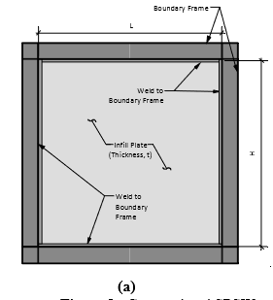
STEEL PLATE SHEAR WALL

Slide 4
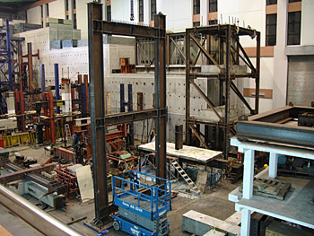
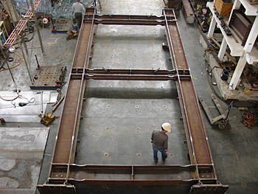
STEEL PLATE SHEAR WALL

Slide 5
ADVANTAGES
Large energy dissipation- stable hysteresis
High initial stiffness- limiting wind drift
Lighter- reduces seismic load
Shop-welded, field-bolted, fast
Thin sections – more work space
Cold regions
Retrofitting- panels can be replaced

Slide 6
When a plate is subjected to a lateral load the diagonal which gets loaded in compression, buckles and cannot support additional load on the other hand, the diagonal in tension continues to take more load and the plate becomes like a triangular truss with only tension diagonals, which is known as tension field action.
TENSION FIELD ACTION

Slide 7
SCOPE
In existing spsw the infill plates impose high demand on boundary frame incurring additional cost for strengthening work to avoid the premature failure of boundary frame.
We can address this difficulty by limiting the formation of tension field with in the plate so as to decrease the demand on boundary element.
This project focuses on the behaviour of spsw with perforations as an alternative to reduce the demand on boundary elements of SPSWs.

Slide 8
OBJECTIVE
Finite element analysis of steel plate shear wall with perforations to reduce the lateral sway due to earthquake forces.

Slide 9
METHODOLOGY
Literature survey
Modeling of SPSWs -ANSYS WORKBENCH
Validating the model
Finite element analysis of perforated steel plate shear wall
Parametric study
Results and discussions

Slide 10
LITERATURE REVIEW
Sl.no. | Author | Journal paper | Description
1 | Caccese, V., Elgaaly, M. and Chen, R., 1993 | “Experimental Study of Thin Steel-Plate Shear Walls Under Cyclic Load.” Journal of Structural Engineering, ASCE, Vol. 119, No. 2, February, pp. 573-587. | Found that wall with thicker plates was not significally stronger because column yielding was the governing factor.
2 | Elgaaly, M., and Liu, Y., 1997. | “Analysis of Thin Steel Plate Shear Walls.” Journal of Structural Engineering, ASCE, Vol. 123, No. 11, November, pp. 1487-1496 | The non linear behavior of the system starts with yielding of the plate and the strength of the system controlled by the plastic hinge in the columns.

Slide 11
3 | Tromposch, E.W., Kulak, G.L., 1987, | “Cyclic and Static Behaviour of Thin Panel Steel Plate Shear Walls.” Structural Engineering Report No. 145, Department of Civil Engineering, University of Alberta, Edmonton, Canada. | Changing simple beam–to–column connections to rigid beam–to–column connections can increase significantly the energy absorption capacity of the system.
4 | Driver, R.G., Kulak, G.L., Kennedy, D.J.L., and Elwi, A.E., 1997, | “Seismic Behaviour of Steel Plate Shear Walls.” Structural Engineering Report No. 215 | four-story single bay specimen-modeled SPSW under cyclic loading, in order to study its detailing and overall performance subject to a severe earthquake.
5 | J. Neal, S.M. ASCE, B. Qu, M .ASCE. | “Steel Plate Shear Walls with Controlled Infill Tension Fields”. Journal of Structural Engineering, ASCE | In this tension field formation was controlled by discontinuous infill to boundary connections.

Slide 12
6 | Timler, P. A., Kulak, G. L. (1983). | “Experimental study of steel plate shear Walls”. The University of Alberta. Dept. of Civil Engineering. | Fabricated a large-scale single storey, and tested it under cyclic loading of service and ultimate load levels. The tension ﬁeld development in web plate and the structural deformation under the cyclic service load were the focus of the experimental program
7 | Lubell, A.S., Prion, H.G.L., Ventura, C.E., and Rezai, M., 2000, | “Unstiffened Steel Plate Shear Wall Performance under Cyclic Load.” Journal of Structural Engineering, ASCE, Vol. 126, No. 4, April, pp. 453-460. | Tested two single and one 4-story thin SPSWS without stiffeners under cyclic loading. They concluded that the existing of steel shear plate in frame results in reduction of the rotation in the moment resisting connection and protects the frame from severe damage.

Slide 13
8 | Wagner, H. (1931). | “Flat Sheet Metal Girders with very Thin Webs. Part I. General Theories and Assumptions”. Tech Memo. National Advisory Committee for Aeronautics, Washington D. C., No. 604. | Used a complete and uniform tension field to determine the shear strength of a panel with rigid flanges and very thin web, and inferred that the shear buckling of a thin aluminum plate supported adequately on its edges does not constitute failure, this idea has been recently developed for modelling of thin SPSWs.
9 | Qu and Bruneau (2008) | “Seismic design of boundary frame members of steel plate shear walls” ASCE Journal of Structural Engineering | Investigate the relative and respective contributions of boundary frame moment resisting action and infill panel tension field action to the overall plastic strength of SPSWs.

Slide 14
10 | Purba and Bruneau | “Seismic Performance of Steel Plate Shear Walls Considering Two Different Design Philosophies of Infill Plates. I: Deterioration Model Development” ASCE journal of struct engg. | To investigate the seismic performance of SPSWs having infill plates designed to resist different percentages of the total lateral loads .
11 | Astaneh-Asl (2001) | “Seismic behavior and design of steel shear walls” Structural Steel Educational Council Technical Information and Product Service, 2001. | Both stiffened and unstiffened panels were examined and it was recommended that unstiffened infill plates be used unless there are openings in the shear wall that require stiffening. A chart was prepared for checking each member in a steel plate shear wall system. Ductile failure modes are ranked as more desirable than brittle failure modes and are arranged first.

Slide 15
12 | Bruneau And Bhagwagar (2002) | “Seismic retrofit of flexible steel frames using thin infill panels”. Engineering Structures 24 (2002) Elsevier | They conducted nonlinear inelastic dynamic analyses to investigate how structural behavior is affected when thin infills of steel, low-yield steel and other nonmetallic materials are used to seismically retrofit steel frames located in regions of low and high seismicity
13 | Behbahanifard, M. R., Grondin, G. Y., and Elwi, A. E. (2003). | “Experimental and numerical investigation of steel plate shear wall” Struct. Eng. Univ. of Alberta, Edmonton, Alberta, Canada | The objectives of the test was to observe the ultimate capacity of the wall and behavior of the boundary members under extreme loading conditions. The specimen reached its ultimate capacity at a deflection of seven times the yield deflection. The specimen displayed high elastic stiffness, high ductility and high dissipation energy.

Slide 16
14 | Dipti Ranjan Sahoo, Balsher Singh Sidhu, and Arunesh Kumar | “Behavior of Unstiffened Steel Plate Shear Wall with Simple Beam-to-column connections and Flexible Boundary Elements” International Journal of Steel Structures | This study investigates the effect of type of beam-to-column connections on the overall performance of steel plate shear wall systems under lateral loading condition.
15 | Anjan K. Bhowmick , Gilbert Y. Grondin , Robert G. Driver | “Nonlinear seismic analysis of perforated steel plate shear walls” Journal of Constructional Steel Research | The behaviour of unstiffened steel plate shear walls with circular perforations in the infill plates is examined. A shear strength model of the infill plate with multiple circular openings is proposed based on a strip model.

Slide 17
Findings from literature review
When a lateral load applied on SPSW more demand is produced on boundary elements .So in order to strengthen them ,adoption of large cross-section profiles are required.
When perforations are introduced in the steel plate, the tension field will reduce which will limit the demand on surrounding frames

Slide 18
VALIDATION
Journal :
Perforated metal shear panels as bracing devices of seismic-resistant structures by A. Formisano et al , L. Lombardi et al, F.M. Mazzolani et al (2016) , Elsevier
Infill plate dimensions : 500×500×0.7mm
Vertical and horizontal boundary elements : UPN 120

Slide 19
MATERIALS USED
Boundary frame members A572 GRADE 50
infill plate was ASTM A36 steel
Grade | Yield strength(Mpa) | Tensile strength(Mpa)
A572 | 390 | 450
A36 | 250 | 400-550

Slide 20
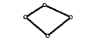
ELEMENTS USED
SHELL 181: 4 noded structural shell,4 nodes,3D space, DOF:UX,UY,UZ,ROTX,ROTY,ROTZ
Notes:
Change the figure of shell 181,,,, insert figure with all dof marked

Slide 21
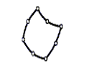
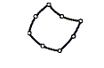
CONTACT ELEMENTS
TARGE170
Contact 3-D Target Segment,8 nodes,3-D space DOF: UX, UY, UZ, TEMP
CONTA174
3-D 8-Node Surface-to-Surface Contact,8 nodes 3-D space DOF: UX, UY, UZ, TEMP, VOLT, MAG
Notes:
Change the figures of target and contact elements

Slide 22
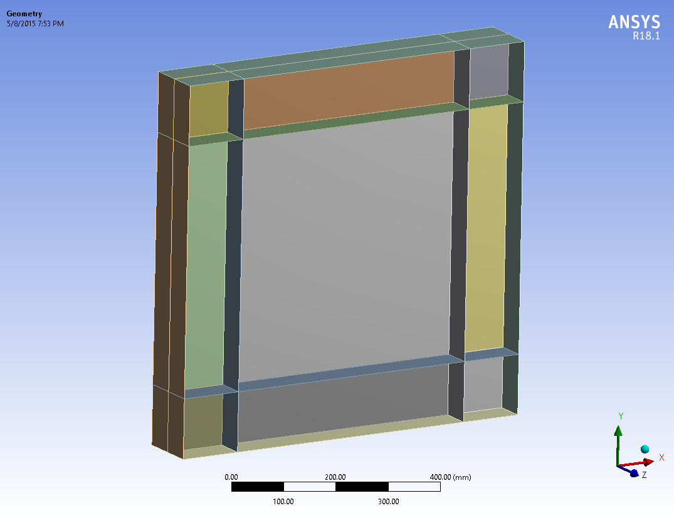
MODEL OF STEEL PLATE SHEAR WALL

Slide 23
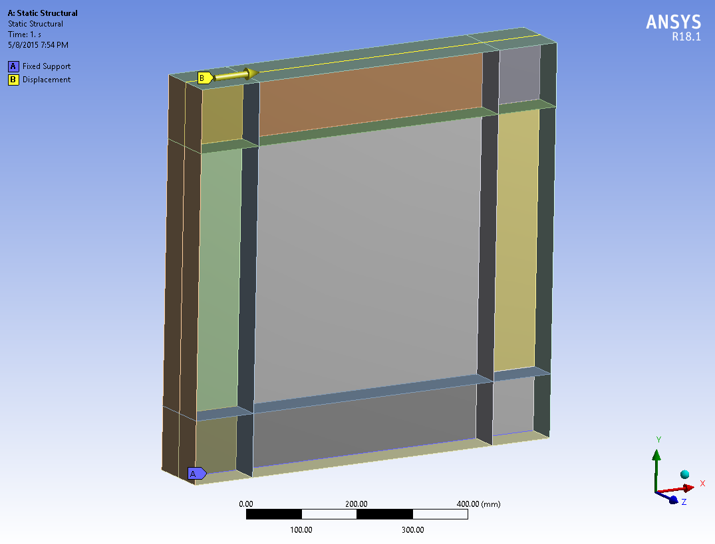
BOUNDARY CONDITIONS

Slide 24
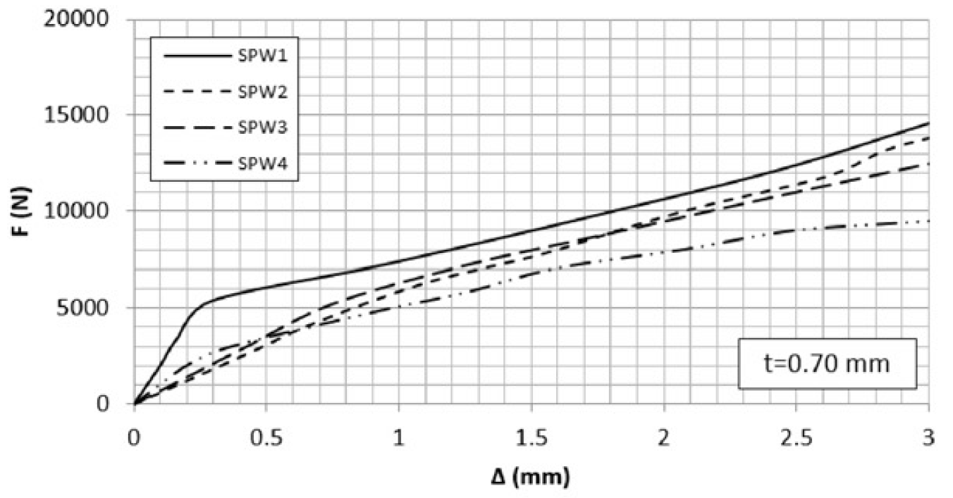
Load displacement graph from journal
Load displacement graph from Ansys
Displacement in mm
From validation journal | From FE analysis done in ANSYS | % Difference
3 | 3.12 | 4

Slide 25
FINITE ELEMENT ANALYSIS OF SPSW WITH PERFORATIONS

Slide 26
Dimensions and Properties
Infill plate dimensions : 500mm×500mm
Vertical and horizontal boundary elements : ISMC 125

Slide 27
Parameters considered for study
Thickness of infill plate – 3.7 mm and 7 mm
Number of holes – one , two and four holes
Diameter of holes – 75 mm and 100 mm
Alignment of holes
Aspect ratio

Slide 28

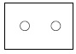
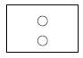
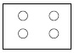
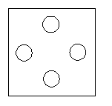
Alignment of perforations

Slide 29
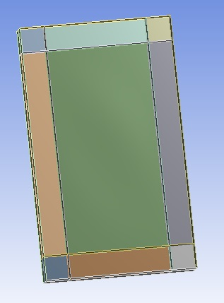
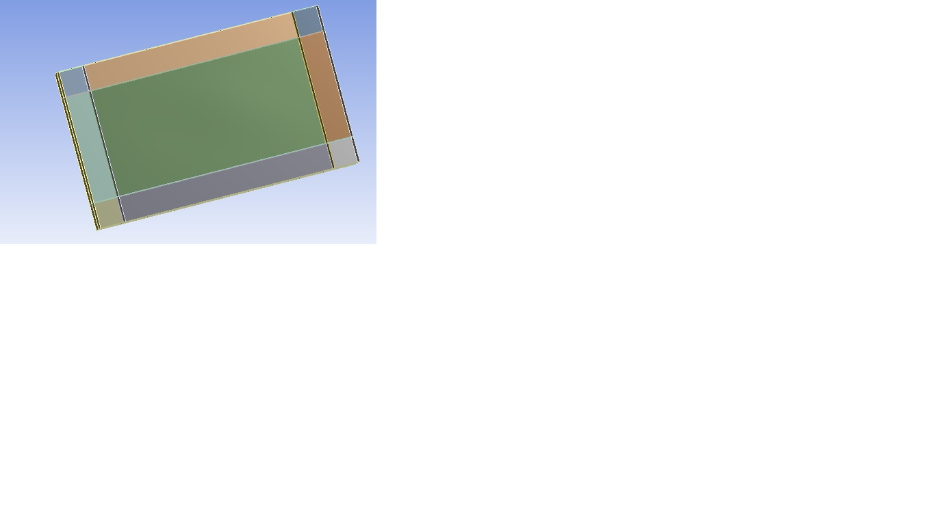
Aspect ratios
Aspect ratio-1:1
500mm x 500 mm
Aspect ratio - 1.5:1
750 mm x 500 mm
Aspect ratio – 1:1.5
500 mm x 750 mm

Slide 30
Effect of thickness of plate - Plate with no hole
500mm×500mm infill plate with thicknesses : 0.37mm and 0.7mm
LOAD DEFLECTION CURVE

Slide 31
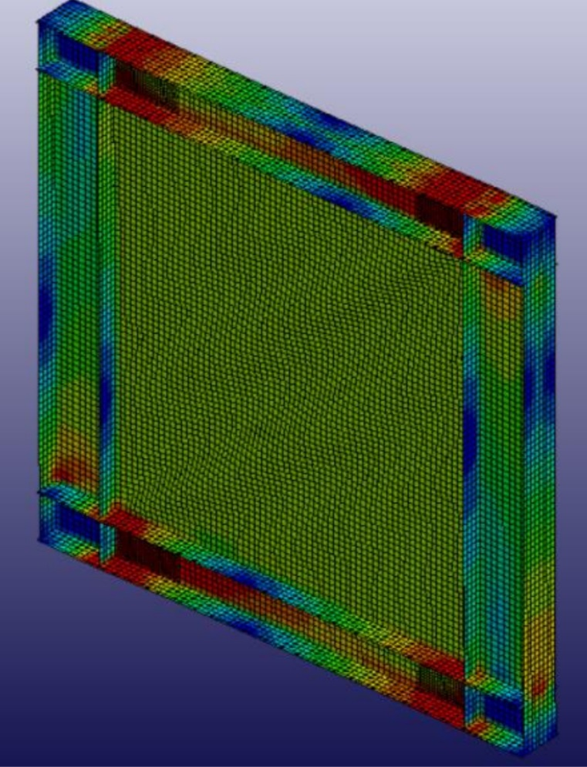
Equivalent stress distribution in Conventional steel plate shear wall

Slide 32
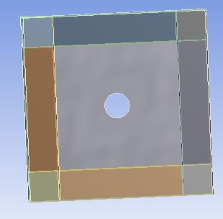
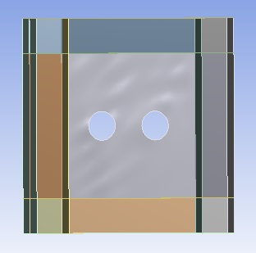
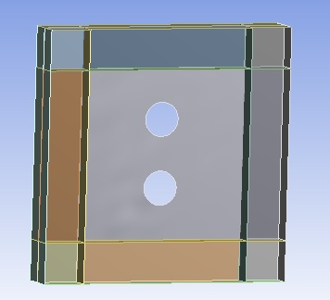
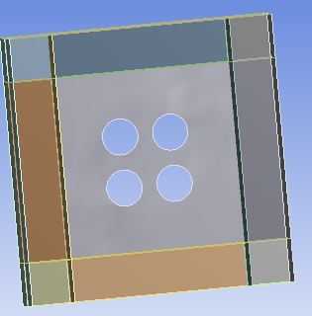
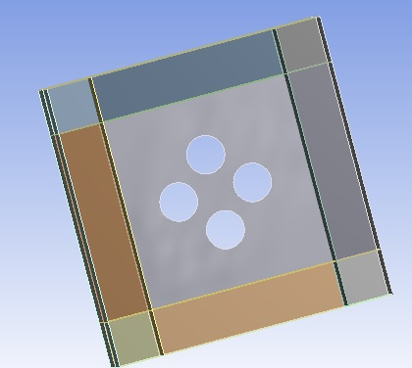
Models of steel plate shear walls with different perforations

Slide 33
Effect of thickness of plate and diameter of hole- Plate with one hole
LOAD DEFLECTION CURVE OF PSPSW WITH VARYING THICKNESS AND HOLE DIAMETER

Slide 34
LOAD DEFORMATION CURVES OF SPSW WITH TWO AND FOUR HOLES
PSPSW with thickness T1 and diameter of hole D2
PSPSW with thickness T2 and diameter of hole D2
PSPSW with thickness T1 and diameter of hole D1
PSPSW with thickness T2 and diameter of hole D1

Slide 35
Discussions
Max. load for T1 Thickness plate |  | Max. load for T2 Thickness plate
D1 diameter | D2 diameter | D1 diameter | D2 diameter
15000N | 19000N | 33000N | 37000N
Comparing thickness of plates, plate with greater thickness is found to have larger load carrying capacity
It is found that when the diameter of hole increases the load carrying capacity also increases.

Slide 36
Influence of aspect ratio and hole orientations

Slide 37
For aspect ratio 1:1

Slide 38
For aspect ratio 1:1
Number of holes | Deformation(mm)
One hole | 29.13
Two hole -H | 37.52
Two hole -V | 37.545
Four hole -H | 37.523
Four hole -V | 37.556

Slide 39
Load deformation curves of SPSW without hole and with one hole
Plate with aspect ratio 1.5:1

Slide 40
Load deformation curves of SPSW with two and four perforations
Plate with aspect ratio 1.5:1

Slide 41
For aspect ratio 1.5:1

Slide 42
For aspect ratio 1.5:1
Number of holes | Deformation(mm)
One hole | 26.281
Two hole -H | 28.146
Two hole -V | 30.06
Four hole -H | 30.015
Four hole -V | 28.164

Slide 43
Load deformation curves of SPSW without perforations and with one hole
Plate with aspect ratio 1:1.5

Slide 44
Load deformation curves of SPSW with two and four perforations
Plate with aspect ratio 1:1.5

Slide 45
For aspect ratio 1:1.5

Slide 46
For aspect ratio 1:1.5
Number of holes | Deformation(mm)
One hole | 46.72
Two hole -H | 47.02
Two hole -V | 49.21
Four hole -H | 49.53
Four hole -V | 46.94
Notes:
Combine these three in one table

Slide 47
CONCLUSIONS
Due to the weakening effect induced by the holes in the plates ,the perforated panels reduce the demand on boundary elements thus making it suitable in seismic regions
In two hole case,
Horizontal hole shows highest load and medium deformation
In four hole case,
Vertical type shows the highest load and least deformation.
Aspect ratio 1.5 is the best one among three aspect ratios

Slide 48
LIST OF PUBLICATIONS
“Finite element analysis of steel plate shear wall”, International Research Journal of Engineering and Technology (IRJET), Vol. 5, issue 7, July (2018).

Slide 49
REFERENCES
Thorburn, L.J., Kulak, G.L., and Montgomery, C.J. (1983). Analysis of steel plate shear walls. Structural Engineering Report No. 107, Department of Civil Engineering ,University of Alberta, Edmonton, Alberta, Canada.
Timler, P.A. and Kulak, G.L. (1983), "Experimental Study of Steel Plate Shear Walls", Structural Engineering Report No. 114, Department of Civil Engineering, University of Alberta, Edmonton, Alberta, Canada.
Elgaaly, M., Caccese, V., and Du, C. (1993), “Post buckling Behavior of Steel-Plate Shear Walls Under Cyclic Loads”, Journal of Structural Engineering, ASCE, Vol. 119, No. 2, Feb. 1993, pp. 588-605.
Caccese, V. and Elgaaly, M. (1993). Experimental study of thin steel-plate shear walls under cyclic load. J. of Structural Engg, ASCE, 119, n. 2, pp.573-587.
Xue, M. and Lu, L-W. (1994). Influence of steel shear wall panels with surrounding frame members. Proceedings. SSRC Annual Technical Session.Pp 339-354.
Driver, R. G., Kulak, G. L., Kennedy, D. J. L., and Elwi, A. E.(1997).“Seismic behavior of steel plate shear walls.” Struct. Eng. Rep.215,Dept. of Civil Engineering, Univ. of Alberta, Edmonton, Alberta, Canada.
Elgaaly, M., and Lui, Y. (1997), “Analysis of Thin-Steel-Plate Shear Walls”, Journal of Structural Engineering, ASCE, Vol. 123, No. 11, Nov.1997, pp 1487-1496.

Slide 50
Timler P.A.,Ventura C.E.,Prion H.,Anjam R. Experimental and analytical studies of SPSW as applied to the design og tall building.The structural design of tall building,1998 7(3) ,233-249
Rezai, M. (1999). “Seismic Behaviour of Steel Plate Shear Walls by Shake Table Testing,” PhD Dissertation, Department of Civil Engineering, University of British Columbia, Vancouver, Canada.
Abolhassan Astanah- Asl, “Seismic Behaviour and Design of steel plateshear walls”, SEONC seminar, Nov- 2001, San Francisco, pg.no. 1 to 18.
Astaneh, Abolhassan. “Seismic Behavior and Design of Steel Plate ShearWalls,” Structural Steel Educational Council Steel Tips. January 2001
Kulak G.L.,Keneddy D.J.L.,Driver R.G.,Medhekar M.S., steel plate shearwalls: An Overview.AISC Engineering Journal,2001,First Quarter,38,50-62
Bruneau M, Bhagwagar T. Seismic retrofit of flexible steel frames usingthin infill panels. Engineering Structures 2002;24(4):443_53.
Behbahanifard, M. R., Grondin, G. Y., and Elwi, A. E. (2003).“Experimental and numerical investigation of steel plate shear wall.” Struct.Eng. Rep. 254, Dept. of Civil Engineering, Univ. of Alberta, Edmonton,Alberta, Canada
Berman, J.W., and Bruneau, M. (2005), “Experimental Investigation ofLight-GaugeSteel Plate Shear Walls”, Journal of Structural Engineering, ASCE, Vol. 124,No. 2, Feb. 1998, pp. 121-130.

Slide 51
Thank you

